Slide 1

Building a Research Program for Scripting Languages
Arjun Guha Ben Lerner Joe Gibbs Politz Justin Pombrio Junsong Li Hannah Quay-de la Vallee John Wrenn and several others! … and Shriram Krishnamurthi

Slide 2
> [] + []
// empty string
> [] + {}
[object Object]
> {} + []
0
> {} + {}
NaN
https://www.destroyallsoftware.com/talks/wat/
Gary Bernhardt

Slide 3
function bar(x) {
return function() {
var x = x;
return x;
};
}
var f = bar(200);
f()
→ 200
function bar(x) {
return function() {
var x = x;
return x;
};
}
var f = bar(200);
f()
→ undefined

Slide 4
[][(![]+[])[!+[]+!+[]+!+[]]+(!![]+[][(![]+[])[+[]]+(![]+[]+[][[]])[+!+[]+[+[]]]+(![]+[])[!+[]+!+[]]+(!![]+[])[+[]]+(!![]+[])[!+[]+!+[]+!+[]]+(!![]+[])[+!+[]]])[+!+[]+[+[]]]+(!![]+[])[+!+[]]+(!![]+[])[+[]]][([][(![]+[])[+[]]+(![]+[]+[][[]])[+!+[]+[+[]]]+(![]+[])[!+[]+!+[]]+(!![]+[])[+[]]+(!![]+[])[!+[]+!+[]+!+[]]+(!![]+[])[+!+[]]]+[])[!+[]+!+[]+!+[]]+(![]+[])[+!+[]]+(![]+[])[!+[]+!+[]]+(![]+[])[!+[]+!+[]]]()[(![]+[])[!+[]+!+[]]+(!![]+[][(![]+[])[+[]]+(![]+[]+[][[]])[+!+[]+[+[]]]+(![]+[])[!+[]+!+[]]+(!![]+[])[+[]]+(!![]+[])[!+[]+!+[]+!+[]]+(!![]+[])[+!+[]]])[+!+[]+[+[]]]+([][(![]+[])[+[]]+(![]+[]+[][[]])[+!+[]+[+[]]]+(![]+[])[!+[]+!+[]]+(!![]+[])[+[]]+(!![]+[])[!+[]+!+[]+!+[]]+(!![]+[])[+!+[]]]+[])[!+[]+!+[]+!+[]]+(![]+[])[+!+[]]+(!![]+[])[+[]]+(![]+[]+[][[]])[+!+[]+[+[]]]+(!![]+[][(![]+[])[+[]]+(![]+[]+[][[]])[+!+[]+[+[]]]+(![]+[])[!+[]+!+[]]+(!![]+[])[+[]]+(!![]+[])[!+[]+!+[]+!+[]]+(!![]+[])[+!+[]]])[+!+[]+[+[]]]+([][[]]+[])[+!+[]]]
a.k.a., window.location
http://discogscounter.getfreehosting.co.uk/js-noalnum_com.php
“Converts javascript command [to use] only []()+! characters”

Slide 5



Let’s not let Python feel left out
def f(x):
class C(object):
x = "C's x"
def meth(self):
return x + ', ' + C.x
return C
f('input x')().meth()

Slide 6
Goal of Our Research Program

Slide 7
Program Reasoning
Static reasoning
Type-based reasoning
Security reasoning
Information for optimization
Information for programming environments
…
Sound reasoning
Because lying is both bad and dangerous

Slide 8
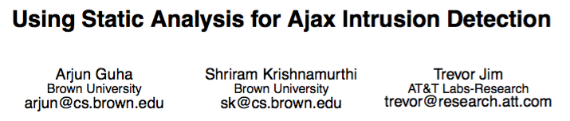

Slide 9
to soundly enforce the policies mentioned above, […] needs to statically reason about the program heap. To this end, this paper proposes the first points-to analysis for JavaScript
In our staging framework, the heavyweight flow analysis is carried out just once on the server and its results are distilled into succinct residual checks, that enjoy two properties. First, they soundly describe the properties that are left to be checked on the remaining code once it becomes known
We present a static program analysis infrastructure that can infer detailed and sound type information for JavaScript programs using abstract interpretation.

Slide 10
Soundness requires proof
Proof requires truth
Truth is given in a semantics
But first…

Slide 11
what is a scripting language?

Slide 12
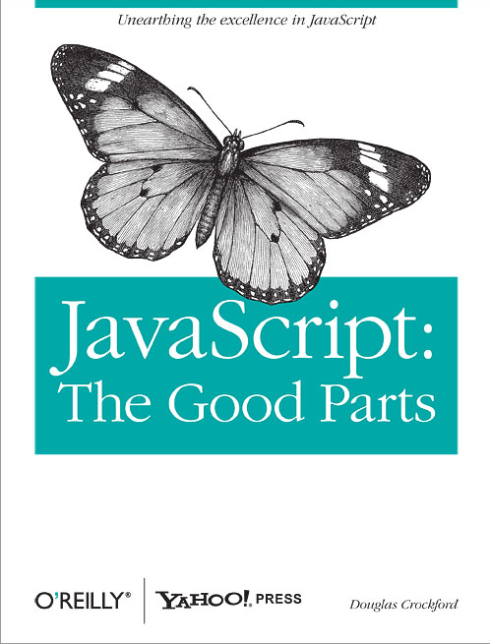
"JavaScript has much in common with Scheme […] Because of this deep similarity …"
(
)

Slide 13
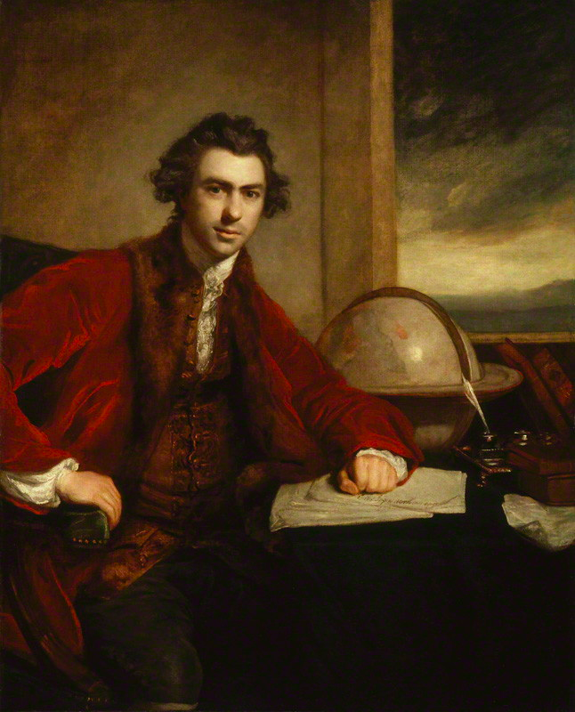

This is a scripting language!
http://www.thelanddownunder.com.au/content/product/full/Platypus_IndoorOutdoor_Statue-164-4.jpg
https://upload.wikimedia.org/wikipedia/commons/6/6e/Joseph_Banks_1773_Reynolds.jpg

Slide 14
"JavaScript has much in common with Scheme […] Because of this deep similarity …"
(
)
No help to researchers studying Web security, building JavaScript analyses, etc.

Slide 15
Technical Issues
Concept
Example
objects = dictionaries
in-language reflection
odd scoping rules
overloading
too many behaviors
value redefinition
antisyntactic definition
eval
o.x = o[“x”]
if (hasField(o, “x”))
x = x
+
{} + []
XMLHttpRequest = …
if = …
eval
All these “features” are antithetical to static reasoning

Slide 16
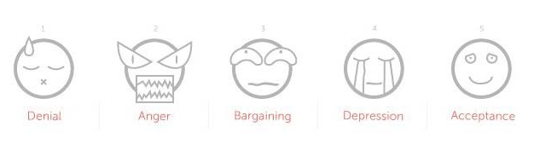
Scripting languages are like objects found in nature
The correct “science” is natural science, experimental in flavor
https://media.licdn.com/mpr/mpr/p/7/005/0ae/142/1c3962e.jpg

Slide 17
Semantics
Type Systems
Security and Other Uses
Issues with Desugaring
Future Directions

Slide 18
Semantics for a Scripting Language

Slide 19
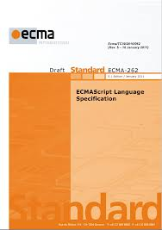
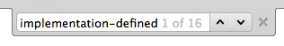
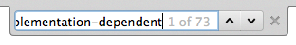
What About the Spec?
Spec is embodied in implementations
Spec is incomplete: e.g., SES depends on window.console
Spec depends on implementations
Attackers attack implementations, not specs

Slide 20
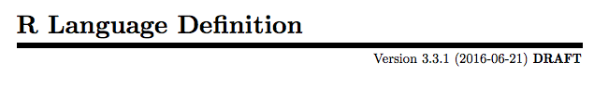
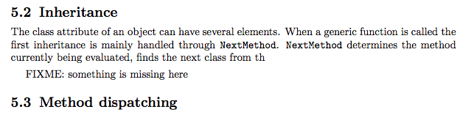
https://cran.r-project.org/doc/manuals/r-release/R-lang.pdf#page=33

Slide 21
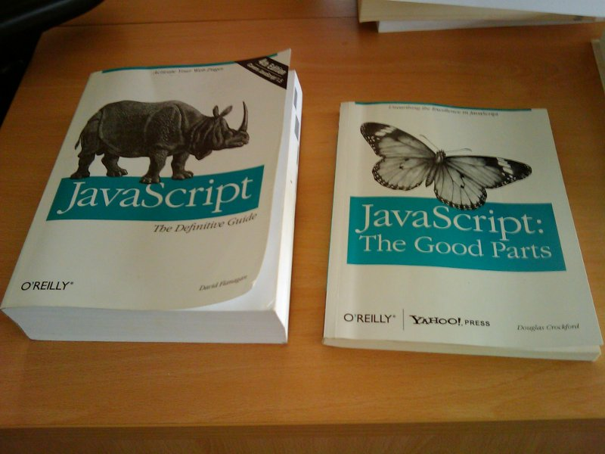
Thanks, Emery Berger

Slide 22
Two Key Properties
Correctness (Is it right?)
Completeness (Does it cover the whole language?)

Slide 23
JavaScript program
A tested semantics
SpiderMonkey, V8, Rhino
Semantics
“their answer”
“our answer”
identical for some large test suite

Slide 25
Control Operators
if, ?:
while, for, do, for in
switch, continue, break, label:
&&, ||, throw, try catch finally

Slide 26
Three Two Key Properties
Correctness (Is it right?)
Completeness (Does it cover the whole language?)
Is it … useful?

Slide 27
Four Three Two Key Properties
Correctness (Is it right?)
Completeness (Does it cover the whole language?)
Is it … useful?
Is it … insightful?

Slide 28
JavaScript program
desugar
λ_{JS} program
SpiderMonkey, V8, Rhino
100 LOC interpreter
“their answer”
“our answer”
identical for some large test suite

Slide 29
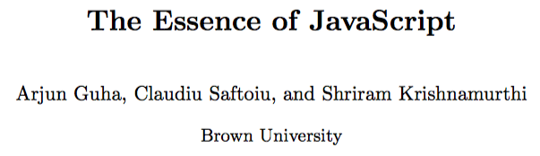
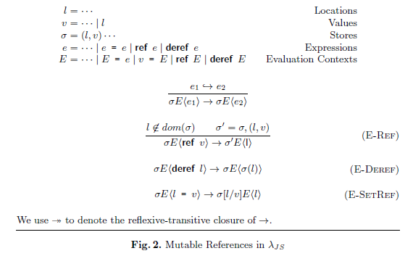
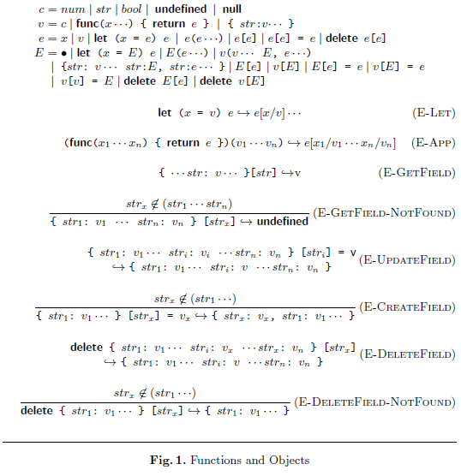
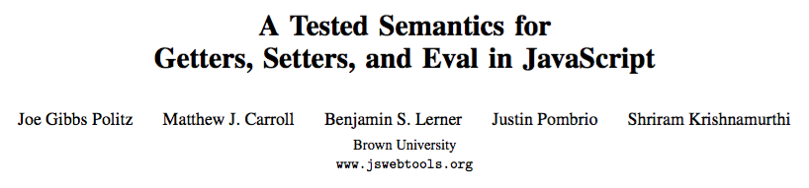
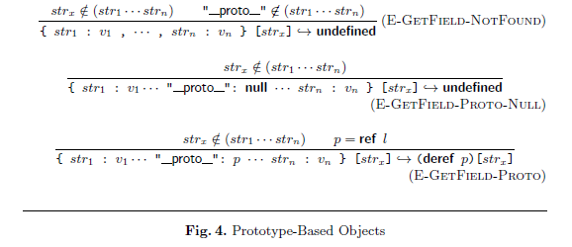
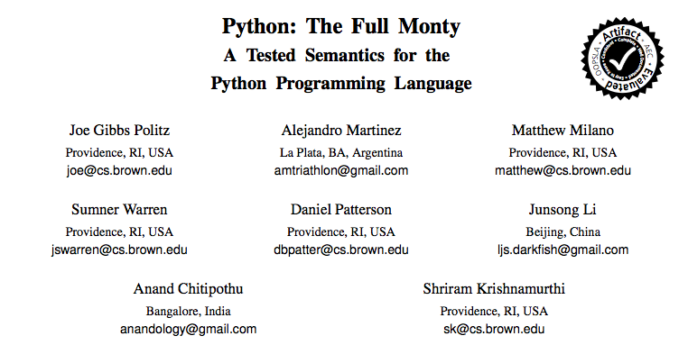

Slide 30
L program
desugar
λ_{L} program
Curated “essence”—provides insight
Target for proofs
Target for tools
What we as scientists should do
L evaluator
λ_{L} evaluator
“their answer”
“our answer”

Slide 31
Semantics
Type Systems
Security and Other Uses
Issues with Desugaring
Future Directions

Slide 32
Types for Scripting Languages

Slide 33
Security and Other Uses
Putting Types to Work

Slide 34
✗Expected function, got string
"not-a-func"(3)
null["x"]
✗Expected object, got null

Slide 35
Typed JavaScript
Web Sandbox Verification
✗
OK!
"not-a-func"(3)
null["x"]
"not-a-func"(3)
null["x"]
✗
OK!
Normal type-safety properties are non-properties for the sandbox

Slide 36
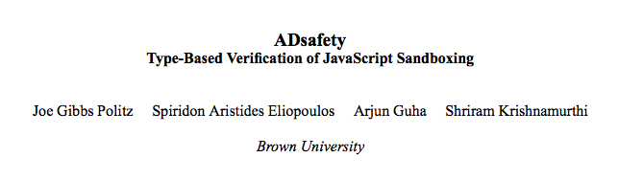
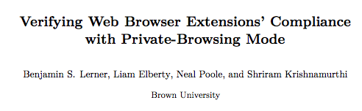
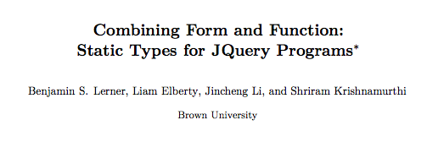

Slide 37
Sandbox
JavaScript Type
Checker
FAIL!
Allow Certain Errors
Re-Engineer?
Impractical
Typable Sandbox
Sandbox
Type Checker
Unwanted

Slide 38
JavaScript
Type Checker
jQuery
Type Checker
Sandbox
Type Checker
Extension
Type Checker
We want to control which guarantees we want from the type system.
And those we don’t.
Bring the types to the code, not vice versa.

Slide 39
?
untyped
typed
What does the guarantee mean?
gradual typing
Where does the guarantee apply?

Slide 40
Type Soundness
Preservation
If Γ ⊢ e : τ and e → e’, then
Γ ⊢ e’ : τ
If Γ ⊢ e : τ, then either
e is a value
∃ e’ . e → e’
e is one of a pre-defined set of errors
Progress

Slide 41
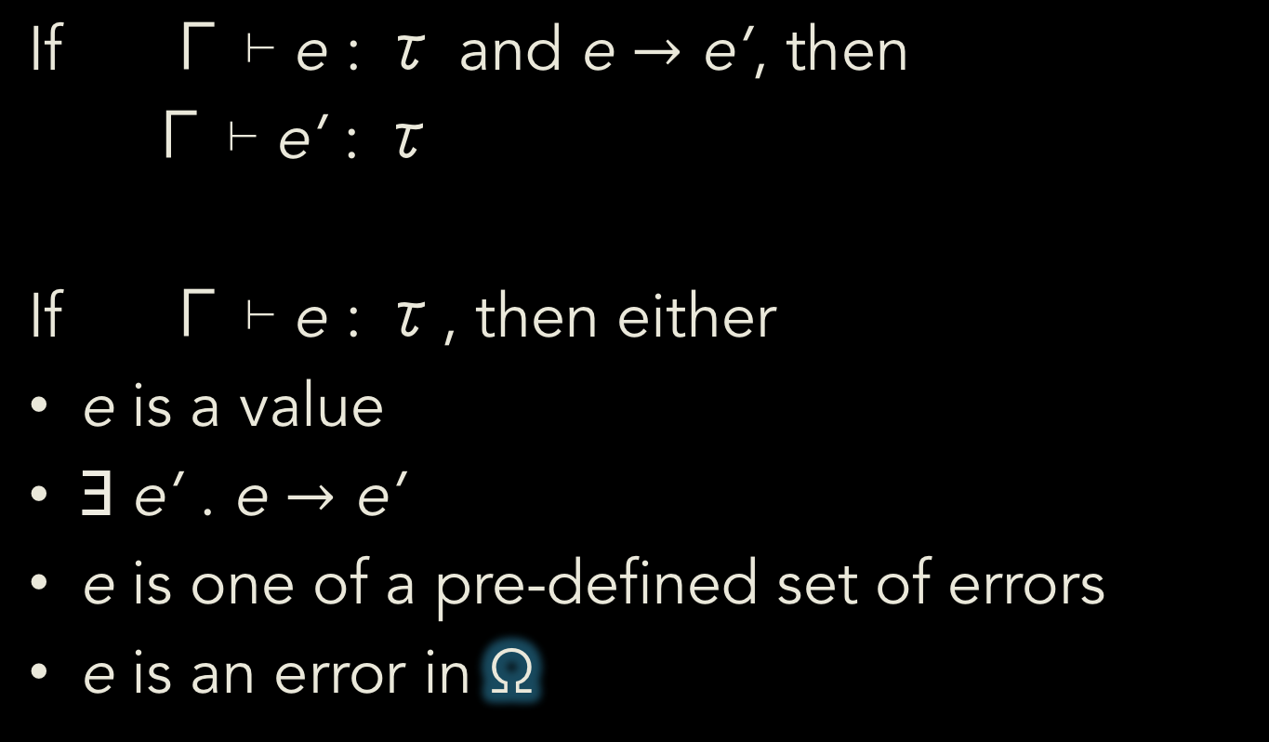
Type Soundness
Preservation
If Γ ⊢ e : τ and e $→$ e’, then
Γ ⊢ e’ : τ
If Γ ⊢ e : τ, then either
e is a value
∃ e’ . e $→$ e’
e is one of a pre-defined set of errors
e is an error in Ω
Ω;
Ω;
Ω;
Progress

Slide 42

typed
What does the guarantee mean?
untyped
gradual typing
Where does the guarantee apply?

Slide 43
Semantics
Type Systems
Security and Other Uses
Issues with Desugaring
Future Directions

Slide 44
Issues with Desugaring

Slide 45
L program
desugar
λ_{L} program
L evaluator
λ_{L} evaluator
“their answer”
“our answer”

Slide 46
var o = new Object()
o.x = 1
{let
(%context = %nonstrictContext)
{%defineGlobalVar(%context,
"o");
%defineGlobalAccessors(%context,
"Object");
{let
(#strict = false)
{%EnvCheckAssign(%context,
"o",
{let
(%constr1 = %context["Object" , {[#proto: null,
#class: "Object",
#extensible: true,]}])
if (prim("!", prim("stx=", prim("typeof", %constr1) , "function")))
{%TypeError("Constructor was not a function")}
else
{{let
(%cproto2 = %constr1["prototype" , {[#proto: null,
#class: "Object",
#extensible: true,]}])
try
{%set-property(%ToObject(%context["o" , {[#proto: null,
#class: "Object",
#extensible: true,]}]),
"x",
1.)}
catch
{%ErrorDispatch}}}}}
{let
(%cproto2 = if (%IsObject(%cproto2))
{%cproto2}
else
{%ObjectProto})
{if (prim("!", %IsObject(%cproto2)))
{%cproto2 := %ObjectProto}
else
{undefined};
{let
(%newobj3 = {[#proto: %cproto2,
#class: "Object",
#extensible: true,]})
if (prim("stx=", %constr1[<#code>] , null))
{%TypeError("Constructor was not applicable")}
else
{{let
(%constr_ret4 = %constr1(%newobj3,
%mkNewArgsObj
({[#proto: null,
#class: "Object",
#extensible: true,]})))
if (%IsObject(%constr_ret4))
{%constr_ret4}
else
{%newobj3}}}}}}}}},
#strict);

Slide 47
function iden(a){return a}
iden(1)
{let
(%context = %nonstrictContext)
{%defineGlobalVar(%context,
"iden");
{let
(#strict = false)
{{let
(%fobj7 = {let
(%prototype5 = {[#proto: %ObjectProto,
#class: "Object",
#extensible: true,]
'constructor' : {#value (undefined) ,
#writable true ,
#configurable false}})
{let
(%parent = %context)
{let
(%thisfunc6 = {[#proto: %FunctionProto,
#code: func(%this , %args)
{%args[delete "%new"];
label %ret :
{{let
(%this = %resolveThis(#strict,
%this))
{let
(%context = {let
(%a4 = %args
["0" , null])
{[#proto: %parent,
#class: "Object",
#extensible: true,]
'arguments' : {#value (%args) ,
#writable true ,
#configurable false},
'a' : {#getter func
(this , args)
{label %ret :
{break %ret %a4}} ,
#setter func
(this , args)
{label %ret :
{break %ret %a4 := args
["0" , {[#proto: %ArrayProto,
#class: "Array",
#extensible: true,]}]}}}}})
{break %ret %context["a" , {[#proto: null,
#class: "Object",
#extensible: true,]}];
undefined}}}}},
{let
(%fun2 = %context["iden" , {[#proto: null,
#class: "Object",
#extensible: true,]}])
{let
(%ftype3 = prim("typeof", %fun2))
if (prim("!", prim("stx=", %ftype3 , "function")))
{%TypeError("Not a function")}
else
{%fun2(undefined,
%mkArgsObj({[#proto: null,
#class: "Object",
#extensible: true,]
'0' : {#value (1.) ,
#writable true ,
#configurable true}}))}}}}}}}
#class: "Function",
#extensible: true,]
'prototype' : {#value (%prototype5) ,
#writable true ,
#configurable true},
'length' : {#value (1.) ,
#writable true ,
#configurable true},
'caller' : {#getter %ThrowTypeError ,
#setter %ThrowTypeError},
'arguments' : {#getter %ThrowTypeError ,
#setter %ThrowTypeError}})
{%prototype5["constructor" = %thisfunc6 , null];
%thisfunc6}}}})
%context["iden" = %fobj7 ,
{[#proto: null, #class: "Object", #extensible: true,]
'0' : {#value (%fobj7) , #writable true , #configurable true}}]};

Slide 48
Why is the Output So Big?
Why is This a Problem?
Intended complexity: small core
Incidental complexity: codegen
Essential complexity: semantics

Slide 49
Semantics-Preserving Rewrites: 10-30% Shrinkage
Dead-code elimination
Constant folding
Constant propagation
Alias propagation
Infer types + eliminate static checks
Unwrap object properties as identifiers
Turn mutation into let-bindings
Clean unused environment bindings
Generic compiler transformations
λ_{JS}-specific transformations

Slide 50
Semantics-Altering Rewrites:

Slide 51
Semantics-altering?!?
All “static” tools handle sub-languages

Slide 52
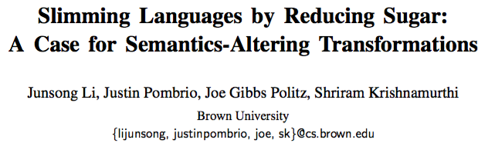
Semantics-Altering
Disable variable-arity functions
Eliminate static safety checks
Gives anywhere from 1-30% reduction
Many more opportunities:
function is not used as constructor
No assignm’t to globals (window, top-level this)
Arithmetic ops applied only to strings or numbers

Slide 53
var o = new Object()
o.x = 1
{let
(o = {let
(%cproto2 = %ObjectGlobalFuncObj["prototype" , {[#proto: null,
#class: "Object",
#extensible: true,]}])
{let
(%newobj3 = {[#proto: %cproto2, #class: "Object", #extensible: true,]})
{let
(%constr_ret4 = %ObjectGlobalFuncObj(%newobj3,
%mkNewArgsObj({[#proto: null,
#class: "Object",
#extensible: true,]})))
if (%IsObject(%constr_ret4))
{%constr_ret4}
else
{%newobj3}}}})
try
{%set-property(%ToObject(o),
"x",
1.)}
catch
{%ErrorDispatch}}
-opt-less-mutation -opt-alias-propagation
-opt-type-infer -opt-const-propagation
-opt-const-folding -opt-no-checks
-opt-deadcode-elimination

Slide 54
function iden(a){return a}
iden(1)
{let
(iden = func(%this , %a4)
{%a4}})
iden(undefined,
1.)}
-opt-preprocess -opt-less-mutation -opt-alias-propagation
-opt-type-infer -opt-fixed-arity -opt-unwrap-lambda -opt-const-propagation
-opt-deadcode-elimination -opt-const-folding

Slide 55
Semantics
Type Systems
Security and Other Uses
Issues with Desugaring
Future Directions

Slide 56
Future Work
Type Systems

Slide 57
Dependent Types
Scripts have extremely dependent types
Illustrative examples:
jQuery shapes
First-class name-based member access
R arrays, vectors: one-dimensional indexing with +num, -num, booleans

Slide 58
Duck Typing
If it looks like structural typing, swims like structural typing, and quacks like structural typing …

Slide 59
Future Work
Toward clearer sub-languages

Slide 60
Sub-Languages
Formalize the sub-languages of papers
These command-line flags are a specification of a paper’s sub-language:
-opt-fixed-arity
-opt-unwrap-lambda
-opt-no-checks

Slide 61
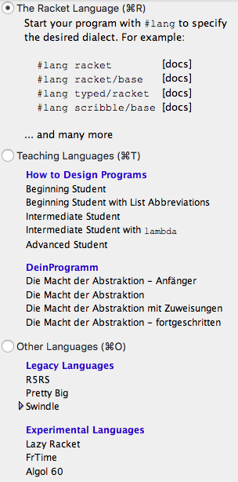
Look for Inspiration

Slide 62
Future Work
Resugaring

Slide 63
Surface T
desugar
Core T₁
How to present as a surface evaluation sequence?
Core T₂
Black-box
transition
system
resugar
Core T₃
Core T₄

Slide 64
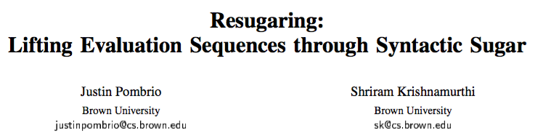
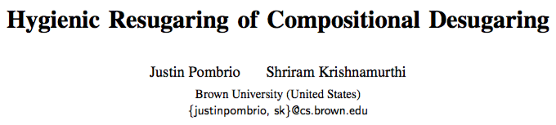
desugar
L
λ_{L}
Three key properties:
Emulation Desugaring a re-sugared term yields the same desugared term
Abstraction Re-sugaring does not show terms introduced by desugaring
Completeness Doesn’t skip expected steps
L
λ_{L}
λ_{L}
λ_{L}
L
λ_{L}

Slide 65
Everything Can (and Should) be Resugared
Evaluation sequences
Scope rules
Types
Error messages…

Slide 66
Future Work
The Next 700 Semantics

Slide 67
Tested Semantics Effort
Artifact | Effort | People
Cisco IOS | 1y x 2 | 1 PhD, 1 MS
EcmaScript 3 | 3m × 2 | 1 PhD, 1 UG
EcmaScript 5 Safe | 5m × 4 | 1 PD, 2 PhD, 1 MS
DOM Events | 7m × 4 | 1 PD, 1 PhD, 1 MS, 1 UG
Python | 9m x 8 | 1 PhD, 3 UG, 3 Other
Scattered worldwide — recruited from a MOOC

Slide 68
L program
desugar
λ_{L} program
Learn this using machine translation techniques

Slide 69
Important Differences
MT Tree Alignment needs:
Lots of sentences of input (easy)
Lots of sentences of output (easy)
Lots of examples of translations (oops!) Typically at least 1mil, preferably 10mil
But MT also lacks something we have…

Slide 70
L program
desugar
λ_{L} program
L evaluator
λ_{L} evaluator
“their answer”
“our answer”
These represent ground truth

Slide 71
Current Status
We’ve tried four different approaches:
Naïve tree matching
Tree transduction by Gibbs sampling
Genetic programming
Sketching
None has yet succeeded beyond toy examples

Slide 72
The Next 700 Semantics
(of which we have ~3)

Slide 73
Coda

Slide 74
The Modelers’ Hippocratic Oath Emmanuel Derman and Paul Wilmott
I will remember that I didn't make the world, and it doesn't satisfy my equations.
Though I will use models boldly to estimate value, I will not be overly impressed by mathematics.
I will never sacrifice reality for elegance without explaining why I have done so.
Nor will I give the people who use my model false comfort about its accuracy. Instead, I will make explicit its assumptions and oversights.
I understand that my work may have enormous effects on society and the economy, many of them beyond my comprehension.
http://www.wilmott.com/blogs/eman/index.cfm/2009/1/8/The-Financial-Modelers-Manifesto

